Slide 1
Date: 02 December 2025

Slide 2




Weekly report: Team Gearbox, Brake, Coupling
Week number : 10
Date: 02/12/2025
Supervisor: Prof. Peter Quell
Group Members :Nehang Jitendra Joshi,Santo Mazumder,Md Razaul Karim Rahat
Presented by -Santo Mazumder
2-12-2025
Gearbox, Brake, Coupling

Slide 3
List of Content
Calculation of the gearbox
3D design of all stages
Bearing use in the gearbox
Cost,Weight and supplier
Coupling Displacement
2-12-2025
Gearbox, Brake, Coupling

Slide 4
Calculations of planetary stages
Nomenclature | Stage 1 | Stage 2
Module(mm) | 16 | 14
i_1 | 5: 1 | 4.9 : 1
z_Sun | 37 | 35
z_Ring | 115 | 110
z_Planet | 39 | 37
No. of Planets | 5 | 4
(z_Sun + z_Ring)/No. Of Planets | 30 | 36
Tooth Depth (mm) | 36 | 31.5
D_Sun(mm) | 592 | 490
D_Planets(mm) | 624 | 525
D_Ring (mm) | 1840 | 1540
Gap (mm) | 5.19 | 5.08
Face Width (mm) | 160 | 140
n_Ring (rpm) | 0 | 0
n_Planet Carrier (rpm) | 10.12 | 100.37
n_Sun (rpm) | 32.38 | 401.48
i_Sun,Planet | 1.5 | 1
n_Planet (rpm) | 30.83 | 32.38
Reference: Lecture Notes by Prof. Peter Quell and PSGdesign book
2-12-2025
Gearbox, Brake, Coupling

Slide 5
Calculation of spur gear stage
Nomenlature | Values
Module(mm) | 9
i_1 | 4.9 : 1
Center Distance(mm) | 351
No of Teeth on Gear | 100
No of Teeth on Pinion | 22
Height Factor(mm) | 1
Tooth Depth(mm) | 20.25
Bottom Clearance (mm) | 2.25
Diameter of input shaft (mm) | 100
Diameter of output shaft (mm) | 150
P.C. Diameter of Gear (mm) | 900
P.C. Diameter of Pinion (mm) | 198
Face width (mm) | 90
Input Shaft (rpm) | 401.48
output Shaft (rpm) | 1200
Reference: Lecture Notes by Prof. Peter Quell and PSGdesign book
2-12-2025
Gearbox, Brake, Coupling

Slide 6
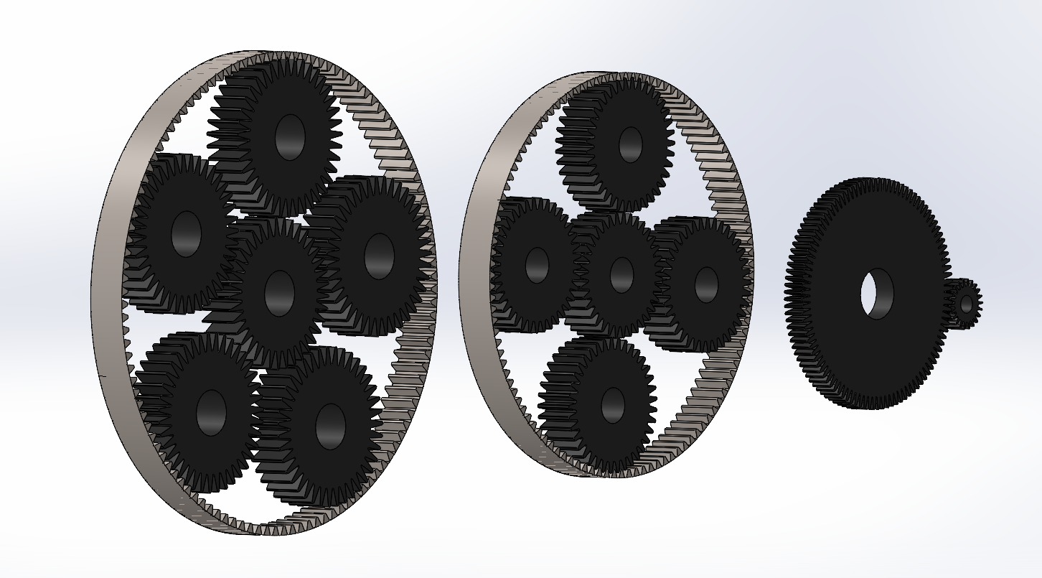
3D model design of all stages
Reference: Own design
2-12-2025
Gearbox, Brake, Coupling

Slide 7
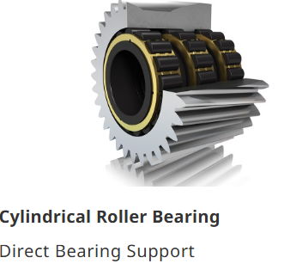
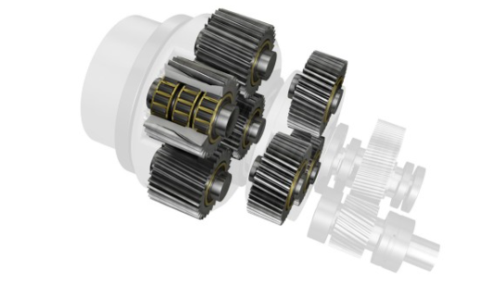
Bearing use in the gearbox
Planet Gear
Source: Gearbox - Schaeffler
2-12-2025
Gearbox, Brake, Coupling

Slide 8
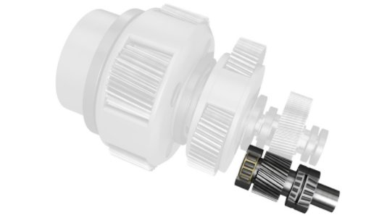
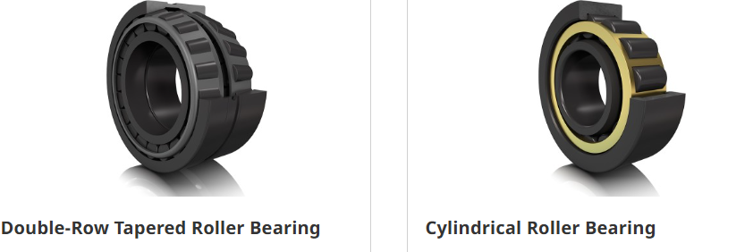
Bearing use in the gearbox
Intermediate / Output Shaft
Source: Gearbox - Schaeffler
2-12-2025
Gearbox, Brake, Coupling

Slide 9
Material
No | Components | Material
1 | Gearbox housing | Cast iron (GJS 400-18-LT)
2 | Gears | 18CrNiMo 7-6 grade steel
3 | Coupling | Cast iron (GJS 400-18-LT)
4 | Brake | Cast iron (GJS 400-18-LT)
2-12-2025
Gearbox, Brake, Coupling

Slide 10
Weight and Cost estimation
No | Components | Weight estimation | Cost estimation
1 | Gearbox Housing * 1 | 6500-7000 Kg | 15700 USD
2 | Gears | 5000-6000 Kg | 33500 USD
3 | Bearings | 1100 Kg | 20500 USD
4 | Brake * 1 | 150 Kg | 3000 USD
5 | Coupling *1 | 200 Kg | 1200 USD
6 | Internal shaft | 3000 Kg | 11000 USD
Total Weight | 19,600 Kg
Total cost | 85,400 – 1,50,000 USD
2-12-2025
Gearbox, Brake, Coupling

Slide 11
Weight and Cost estimation Bolted flange concept
Weight and Cost | 4500 Kg and 32,500 USD
Material | EN-GJS-400-18-LT
Bolts | M39
2-12-2025
Gearbox, Brake, Coupling

Slide 12
Supplier for different components
Components | Supplier name | Location
Gearbox | ZF wind Winergy | Belgium Germany
Brake | Svendborg KTR | Denmark Germany
Coupling | KTR | Germany
Note- Above all the companies are located in Europe but they are able to supply across to 5 continents.
2-12-2025
Gearbox, Brake, Coupling

Slide 13
Various Displacements on Coupling
Components | Type of Displacement
Elastomeric bearing | Radial displacement
Rotor bearing | Axial displacement
Ball bearing | Axial and Angular displacement
Cylindrical Roller bearing (position-main shaft) | Radial displacement
Spherical Roller bearing (Main bearing) | Axial and radial displacement
Tapered Roller bearing (Position- Gearbox) | Axial displacement.
Slewing Ring bearing(position- pitch and yaw) | Axial, radial and angular.
Tower | Angular displacement
2-12-2025
Gearbox, Brake, Coupling

Slide 14
Next Steps
1.Bearing and shaft calculation
2.Draft model of gearbox housing
3.Coupling design and calculation
4.Brake caliper design and calculation
2-12-2025
Gearbox, Brake, Coupling

Slide 15
Bibliography
Gearbox
(1) Previous year Optimus projects(60E,92LE,Shakti 26-11-2025
(2) Roloff Matek Maschinenelemente 28-11-2025
(3) Lecture notes – Mechanical drive train by Prof.Peter Quell.28-11-2025
(4)Shigley's mechanical engineering design and PSG data book 27-11-2025
(5)Gearbox – Schaeffler 30-11-2025
Coupling
(1)Lecture notes-Machinery Components by Prof.Peter Quell 29-11-2025
2-12-2025
Gearbox, Brake, Coupling

